Slide 1
Investment Worthy or Not
Machine Learning Based Investment Decision Prediction
Business Analytics
Machine Learning
Investment Decision Support
A classroom project that explains each Python step from the Jupyter Notebook.
Binary Classification • Logistic Regression • Decision Tree • Hyperparameter Tuning
Predicting whether an investment opportunity is worth investing — directly from the notebook code.

Slide 2
Business Problem
3
Why machine learning for investment decisions?
Context — what investors actually do
Problem Statement
• Investors study many signals before committing capital.
• They look at the company's financial health, growth, risk and market position.
• Manually weighing every factor for every opportunity is slow and inconsistent.
• A data-driven model can convert those signals into a clear Yes / No decision.
“Can Machine Learning predict whether an investment opportunity is worth investing in based on financial, business, and market-related factors?”
Financial
Business
Investment
Annual Revenue • Revenue Growth • Profit Margin
ROE • Current Ratio • Debt-to-Equity
Customer Growth • Customer Retention
Management Experience • Business Risk
Expected ROI • Investment Amount
Market Share • Market Risk • Industry Growth
Investment Worthy or Not • Machine Learning Project

Slide 3
Project Objective
4
What this project will deliver
01
Predict Investment Decision
02
Analyse Important Factors
Use historical data to predict Yes / No for new investment opportunities.
Identify which financial, business & market signals drive the decision.
03
Build Classification Models
04
Compare Model Performance
Train Logistic Regression and Decision Tree classifiers.
Compare Accuracy, Precision, Recall and F1-score side by side.
05
Perform Hyperparameter Tuning
06
Predict for New User Inputs
Use GridSearchCV to improve the models.
Build an interactive input pipeline that returns an investment recommendation.
07
Generate Business Recommendations
Translate model insights into business-level guidance.
Investment Worthy or Not • Machine Learning Project

Slide 4
Project Workflow
5
From raw CSV to business recommendation
01. Business Problem
Business Problem
Frame the investment decision as a Yes / No ML task.
02. Dataset Collection
Dataset Collection
Load Investment_Worthy_Raw_Dataset_.csv.
03. Data Understanding
Data Understanding
Inspect shape, dtypes, unique counts and sample rows.
04. Data Cleaning
Data Cleaning
Handle missing values, ensure consistent dtypes.
05. EDA
EDA
Visualise how each feature relates to the decision.
06. Feature Preparation
Feature Preparation
Select features and encode categorical variables.
07. Train-Test Split
Train-Test Split
80 % training, 20 % testing with random_state = 42.
08. Model Building
Model Building
Train Logistic Regression and Decision Tree.
09. Model Evaluation
Model Evaluation
Accuracy, Precision, Recall, F1-score, Confusion Matrix.
10. Hyperparameter Tuning
Hyperparameter Tuning
GridSearchCV to find the best parameters.
11. User Input Prediction
User Input Prediction
Run new inputs through the tuned model.
12. Business Insights
Business Insights
Identify which features matter most.
Investment Worthy or Not • Machine Learning Project

Slide 5
Dataset Overview
6
What the raw investment dataset contains
Total Records
Total Columns
Target Variable
Class Balance
10,000
19
6,456 Yes • 3,544 No
Investment_Decision
Target Variable
Numerical Variables (14)
Categorical Variables (5)
• Investment_Decision — Yes / No
• Yes = Investment Worthy
• No = Not Investment Worthy
• Encoded later as 1 / 0 using LabelEncoder.
• Annual_Revenue
• Revenue_Growth_Pct
• Profit_Margin_Pct
• Debt_to_Equity
• Current_Ratio
• ROE_Pct
• Market_Share_Pct
• Customer_Growth_Pct
• Customer_Retention_Pct
• Management_Experience_Years
• Expected_ROI_Pct
• Investment_Amount
• Industry_Growth_Pct
• Company_Age_Years
• Company_Name (unique ID, dropped from X)
• Industry (e.g. FMCG, Healthcare, Tech)
• Business_Risk (Low / Medium / High)
• Market_Risk (Low / Medium / High)
• Investment_Decision (target)
Investment Worthy or Not • Machine Learning Project

Slide 6
Step 1 — Load & Explore the Dataset
7
Real imports and the exact .read_csv() command from cell 1
Imports — cell 0 of the notebook
Imports
1 import pandas as pd
2 import matplotlib.pyplot as plt
3 import seaborn as sns
4 from sklearn.model_selection import train_test_split, GridSearchCV
5 from sklearn.linear_model import LogisticRegression
6 from sklearn.metrics import accuracy_score, confusion_matrix,
7 classification_report
8 from sklearn.preprocessing import LabelEncoder
9 from sklearn.metrics import precision_score, f1_score, recall_score
• pandas → tables (DataFrame).
• matplotlib / seaborn → EDA charts.
• sklearn models & metrics → training + evaluation.
Data loading — cell 1
pd.read_csv() — what & why
1 df = pd.read_csv(
2 "/content/Investment_Worthy_Raw_Dataset_.csv"
3 )
• Reads the CSV file from disk.
• Stores it in `df` (a Pandas DataFrame).
• `df` becomes the working table for every later step.
• We will inspect, clean and model from `df`.
Quick-explore commands used across cells 2–15
1 df.head() # first 5 rows
2 df.shape # (10000, 19)
3 df.info() # column dtypes + non-null counts
4 df.describe() # numeric summary stats
5 df.isnull().sum() # count of missing values
6 df.dtypes # column data types
Investment Worthy or Not • Machine Learning Project

Slide 7
Step 2 — Data Cleaning
8
Real cells 3, 7 and 13–15 from the notebook
Find missing values & impute with the median
What does it do?
1 df.isnull().sum()
2 # Revenue_Growth_Pct, Profit_Margin_Pct, Current_Ratio,
3 # Market_Share_Pct, Customer_Retention_Pct — 200 each
4
5 df["Revenue_Growth_Pct"] = df["Revenue_Growth_Pct"].fillna(
6 df["Revenue_Growth_Pct"].median())
7 df["Profit_Margin_Pct"] = df["Profit_Margin_Pct"].fillna(
8 df["Profit_Margin_Pct"].median())
9 df["Current_Ratio"] = df["Current_Ratio"].fillna(
10 df["Current_Ratio"].median())
11 df["Market_Share_Pct"] = df["Market_Share_Pct"].fillna(
12 df["Market_Share_Pct"].median())
13 df["Customer_Retention_Pct"] = df["Customer_Retention_Pct"]
14 .fillna(df["Customer_Retention_Pct"].median())
• Counts missing values per column.
• Fills every missing numeric value with the column median.
• After this, `df.isnull().sum()` returns 0 for every column.
Why median?
Result
• Median is robust to outliers.
• Mean can be pulled by extreme values.
• 0 null values in any column.
• 10 000 rows preserved (df.shape → (10000, 19)).
Duplicates & data types — actual outputs from cells 13–15
1 df.duplicated().sum() # 0 → no duplicate rows
2 df['Company_Name'].duplicated().sum() # 0 → all IDs unique
3 df.dtypes # 19 columns: 1 int64, 13 float64, 5 object
Investment Worthy or Not • Machine Learning Project

Slide 8
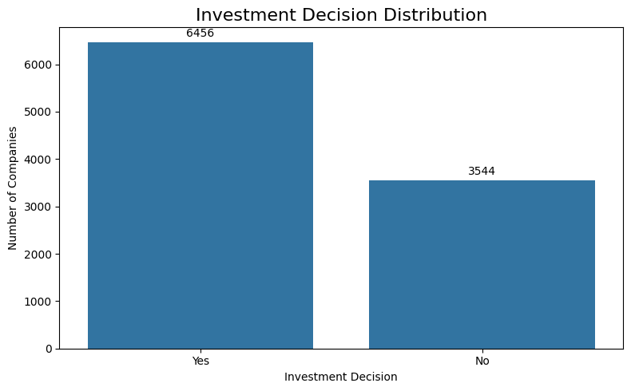
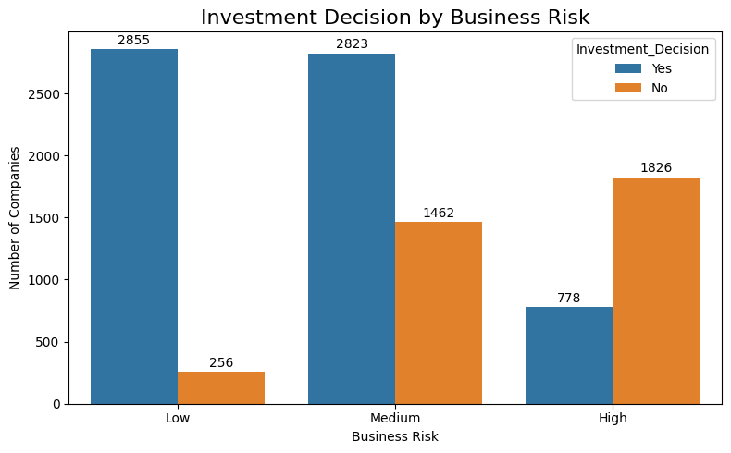
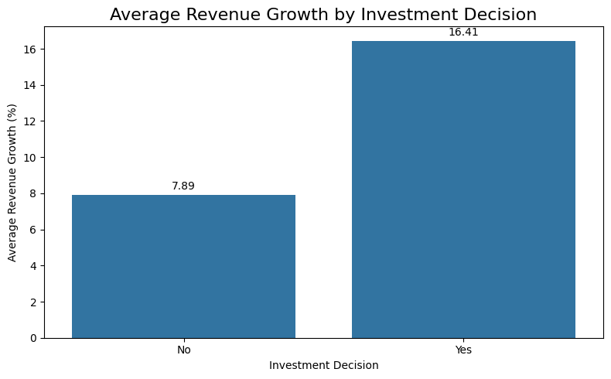
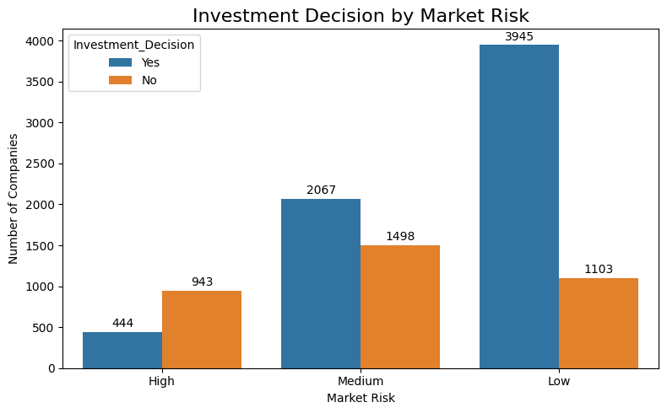
Step 3 — Exploratory Data Analysis
9
How each feature relates to Investment_Decision
Investment Decision Distribution
Yes = 6,456 • No = 3,544. Slight tilt towards worthy, fairly balanced.
Investment Decision by Business Risk
Yes = 6,456 • No = 3,544. Slight tilt towards worthy, fairly balanced.
Avg Revenue Growth
Investment Decision by Market Risk
Yes ≈ 16.41 % vs No ≈ 7.89 %. Strong positive separator.
Low market risk → 3,945 Yes vs 1,103 No. High market risk → 944 Yes vs 943 No — almost a 50/50 split. Risk clearly tilts the decision.
• The clearest separators are Expected ROI, Profit Margin and Revenue Growth — these later become strong features in the Logistic Regression and Decision Tree models.
Why this matters
Investment Worthy or Not • Machine Learning Project

Slide 9
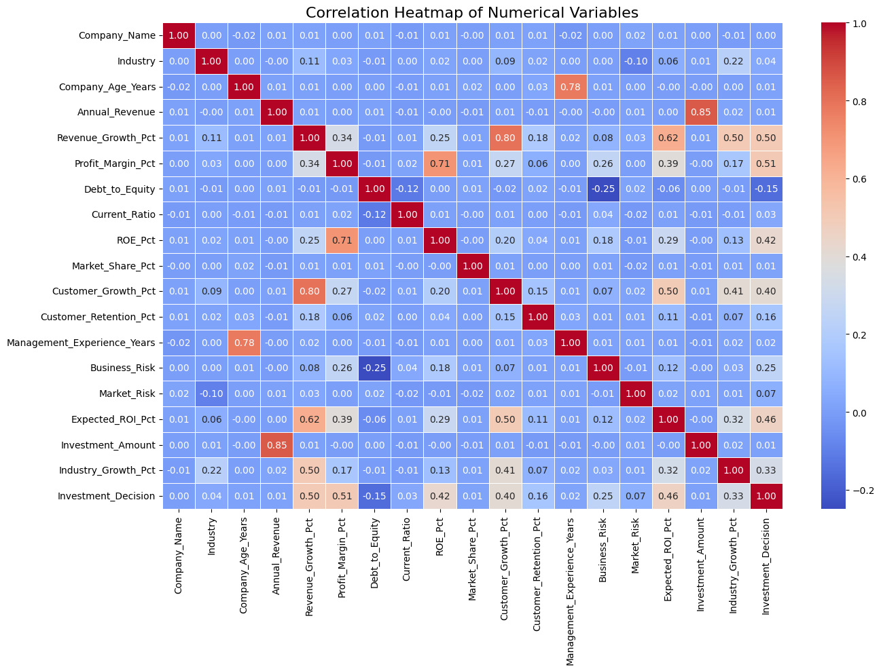
Step 3 (cont.) — Correlation Heatmap
10
What the heatmap tells us: positive correlation between Expected_ROI_Pct, Profit_Margin_Pct and Investment_Decision; Debt_to_Equity is negatively correlated.
Investment Worthy or Not • Machine Learning Project

Slide 10
Step 4 — Feature (X) & Target (y) Selection
11
Real code from cell 29
X = independent variables • y = target
What is X?
1 X = df[[
2 'Industry',
3 'Revenue_Growth_Pct', 'Profit_Margin_Pct',
4 'Debt_to_Equity',
5 'ROE_Pct', 'Customer_Growth_Pct',
6 'Customer_Retention_Pct',
7 'Business_Risk',
8 'Expected_ROI_Pct',
9 'Investment_Amount',
10 'Industry_Growth_Pct'
11 ]]
12
13 y = df['Investment_Decision']
• 11 features chosen for the model.
• Drops Company_Name (unique ID, no signal).
• Drops Annual_Revenue & Current_Ratio (kept on the side).
What is y? Why this target?
• y = Investment_Decision (Yes / No, encoded 1 / 0).
• This is exactly the column the investor needs.
• Yes = 1 → Investment Worthy, No = 0 → Not Worthy.
• Mapping categorical → numeric happens via LabelEncoder (cell 26).
Investment Worthy or Not • Machine Learning Project

Slide 11
Step 5 — Train / Test Split
12
Real code from cell 30
Split the data — cell 30
80 % Training
20 % Test
1 X_train, X_test, y_train, y_test = train_test_split(
2 X, y,
3 test_size = 0.2,
4 random_state = 42
5 )
Parameter explainer
• X → input features (independent vars).
• y → target (Investment_Decision).
• test_size = 0.2 → 20 % held out for testing.
• random_state = 42 → reproducible split.
• Result: 8,000 train rows + 2,000 test rows.
Why split?
• Train on 80 % → model learns patterns.
• Test on 20 % → honest evaluation on unseen data.
• `random_state=42` makes the split reproducible (same rows every run).
• `X.shape = (10000, 11)` → train (8000, 11) and test (2000, 11).
Investment Worthy or Not • Machine Learning Project

Slide 12
Model 1 — Logistic Regression (base, before tuning)
13
Real cells 31–34 from the notebook
Step 1 — create, train, predict
Accuracy
F1 Score
1 from sklearn.linear_model import LogisticRegression
2
3 model = LogisticRegression()
4 model.fit(X_train, y_train)
5
6 y_pred = model.predict(X_test)
0.80
0.85
Precision
Recall
0.82
0.89
Step 2 — evaluate
Confusion Matrix (cell 34) | Pred No | Pred Yes
Actual No | 456 (TN) | 258 (FP)
Actual Yes | 141 (FN) | 1,145 (TP)
1 from sklearn.metrics import (
2 classification_report, confusion_matrix
3 )
4
5 print(classification_report(y_test, y_pred))
6 cm = confusion_matrix(y_test, y_pred)
7 print(cm)
Why?
• Logistic Regression outputs a probability between 0 and 1; we threshold at 0.5 to get Yes / No.
Investment Worthy or Not • Machine Learning Project

Slide 13
Model 1 (cont.) — Logistic Regression with Hyperparameter Tuning
14
Real cells 36–46 — GridSearchCV
Grid search — best parameters
Accuracy (after)
F1 Score (after)
1 param_grid = {
2 'C': [0.01, 0.1, 1, 10, 100],
3 'penalty': ['l1', 'l2'],
4 'solver': ['liblinear']
5 }
6
7 grid_search = GridSearchCV(
8 LogisticRegression(
9 C=0.00001, random_state=42, max_iter=1000
10 ),
11 param_grid=param_grid,
12 cv=5, scoring='f1', n_jobs=-1
13 )
0.85
0.88
Precision (after)
Recall (after)
0.86
0.90
Best parameters (cell 39)
• C = 1 (inverse of regularisation strength)
• penalty = l1 (Lasso, drops weak features)
• solver = liblinear
Fit and re-evaluate
1 grid_search.fit(X_train, y_train)
2 print(grid_search.best_params_)
3 # → {'C': 1, 'penalty': 'l1', 'solver': 'liblinear'}
4
5 y_pred_after = grid_search.predict(X_test)
6 accuracy_score(y_test, y_pred_after)
7 precision_score(y_test, y_pred_after)
8 recall_score(y_test, y_pred_after)
9 f1_score(y_test, y_pred_after)
Metric | Before Tuning | After Tuning
Accuracy | 0.80 | 0.85
Precision | 0.82 | 0.86
Recall | 0.89 | 0.90
F1 Score | 0.85 | 0.88
Investment Worthy or Not • Machine Learning Project

Slide 14
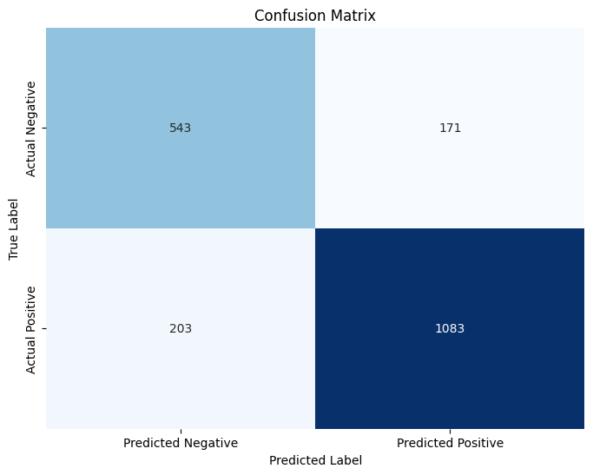
Model 2 — Decision Tree
15
Real cells 55–59 — base model before tuning
Create, train, predict
Accuracy
F1 Score
1 from sklearn.tree import DecisionTreeClassifier
2
3 decision_tree = DecisionTreeClassifier(random_state=42)
4
5 decision_tree.fit(X_train, y_train)
6 y_pred_dt = decision_tree.predict(X_test)
7 y_prob_dt = decision_tree.predict_proba(X_test)[:, 1]
0.8130
0.8528
Precision
Recall
0.8636
0.8421
Evaluation metrics
Decision Tree Confusion Matrix (cell 58)
1 accuracy_dt = accuracy_score(y_test, y_pred_dt)
2 precision_dt = precision_score(y_test, y_pred_dt)
3 recall_dt = recall_score(y_test, y_pred_dt)
4 f1_dt = f1_score(y_test, y_pred_dt)
Why a Decision Tree?
• It handles non-linear relationships between features.
• Easy to visualise as a flowchart of Yes / No questions.
• Serves as a strong baseline to compare with Logistic Regression.
Investment Worthy or Not • Machine Learning Project

Slide 15
Model Comparison — Tuned Decision Tree vs Logistic Regression
16
Real cells 62–64 + cell 46
Tuned Decision Tree — cell 62
Model | Accuracy | F1
LR (base) | 0.80 | 0.85
LR (tuned) | 0.85 | 0.88
DT (base) | 0.81 | 0.85
DT (tuned) | 0.85 | 0.89
1 dt = DecisionTreeClassifier(random_state=42)
2
3 param_grid_dt = {
4 'criterion': ['gini', 'entropy'],
5 'max_depth': [3, 5, 7, 10, None],
6 'min_samples_split': [2, 5, 10],
7 'min_samples_leaf': [1, 2, 4]
8 }
9
10 grid_search_dt = GridSearchCV(
11 estimator=dt, param_grid=param_grid_dt,
12 cv=5, scoring='f1', n_jobs=-1
13 )
14 grid_search_dt.fit(X_train, y_train)
15 best_dt = grid_search_dt.best_estimator_
16 y_pred_dt_tuned = best_dt.predict(X_test)
DT Accuracy
DT F1
0.8515
0.8894
Best DT parameters (cell 62 best_params_)
• criterion = gini max_depth = 5
• min_samples_split = 2 min_samples_leaf = 4
• Best CV F1 = 0.8882
DT Recall
DT Prec.
0.9285
0.8535
Investment Worthy or Not • Machine Learning Project

Slide 16
Step 7 — Predict for a New User Input
17
Real cells 47–54 — actual FMCG sample input
Collect a new investment — cell 47
Model | Prediction | Probability
LR (base) | Worthy | 52.66 %
LR (tuned) | Worthy | 73.38 %
DT (base) | Worthy | 100.00 %
DT (tuned) | Worthy | 91.20 %
1 industry = input("Enter Industry: ")
2 revenue_growth = float(input("Enter Revenue Growth (%): "))
3 profit_margin = float(input("Enter Profit Margin (%): "))
4 debt_to_equity = float(input("Enter Debt to Equity: "))
5 roe = float(input("Enter ROE (%): "))
6 customer_growth = float(input("Enter Customer Growth (%): "))
7 customer_retention = float(input("Enter Customer Retention (%): "))
8 business_risk = input("Enter Business Risk (Low/Medium/High): ")
9 expected_roi = float(input("Enter Expected ROI (%): "))
10 investment_amount= float(input("Enter Investment Amount: "))
11 industry_growth = float(input("Enter Industry Growth (%): "))
Encode and predict
1 user_data = pd.DataFrame({ ... })
2
3 user_data['Industry'] = encoders['Industry'].transform(
4 user_data['Industry'].str.strip())
5 user_data['Business_Risk'] = encoders['Business_Risk'].transform(
6 user_data['Business_Risk'].str.strip())
7 user_data = user_data[X.columns]
8
9 prediction = grid_search.predict(user_data)[0]
10 probability = grid_search.predict_proba(user_data)[0][1]
Live sample input (FMCG company)
• Revenue Growth 1.09 %, Profit 15.26 %, D/E 0.83.
• ROE 17.67 %, Customer Growth -2.93 %.
• Business Risk = Low, Expected ROI 14.26 %.
• All four models classify it as Worthy.
Investment Worthy or Not • Machine Learning Project

Slide 17
Business Insights & Recommendations
18
Insights — what the data is telling us
Business recommendations
• Expected ROI is the strongest separator. Yes ≈ 17 %, No ≈ 10.7 %.
• Higher profit margin and higher revenue growth strongly raise the chance of being worthy.
• High Debt-to-Equity pushes the decision towards Not-Worthy.
• Low business risk + low market risk → overwhelming Yes.
• Technology and Healthcare industries have the highest 'Yes' counts.
• The tuned Logistic Regression and the tuned Decision Tree both reach ~85 % accuracy, F1 ~ 0.88 – 0.89.
• Use the Decision Tree to explain each prediction to non-technical stakeholders.
• Prioritise deals with Expected ROI ≥ 15 % and Debt-to-Equity ≤ 0.85.
• Avoid deals with High Business Risk or High Market Risk unless compensators are strong.
• Collect more granular features (deal size, sector, vintage) to push F1 above 0.90.
Investment Worthy or Not • Machine Learning Project

Slide 18
Conclusion
What we built, what it achieved, and what is next.
Built
Achieved
Next
End-to-end ML pipeline:
loading → cleaning → EDA →
feature prep → modelling →
tuning → user prediction.
Tuned Logistic Regression:
Accuracy 0.85 • F1 0.88.
Tuned Decision Tree:
Accuracy 0.85 • F1 0.89.
Add more features,
try Random Forest / XGBoost,
deploy as a web form,
monitor drift over time.
Thank you • Questions and feedback welcome.

